Slide 1
The Greenest Building: Quantifying The Environmental Value of Building Reuse
FORTIDSMINNEFORENINGEN/ Oslo School of Architecture and Design
5 September 2012
Patrice Frey, Director of Sustainability, nTHP

Slide 2
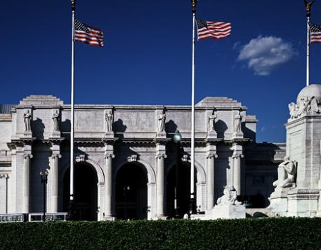
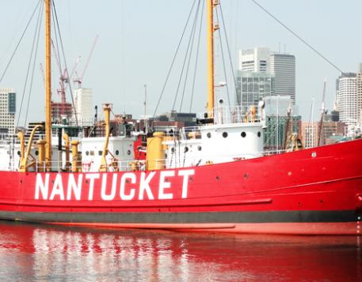
The National Trust for Historic Preservation provides leadership, education, advocacy and resources to help people save the places that matter to them.
Union Station, Washington DC
Nantucket Lightship, Massachusetts
© National Trust for Historic Preservation, 2012
Notes:
National advocacy organization for historic preservation/ heritage conservation in the United States.
Approximately 250,000 members nationwide .
Not a governmental organization – we are non-profit
Based in Washington DC with many field offices throughout the United States; I work in our Chicago field office .

Slide 3

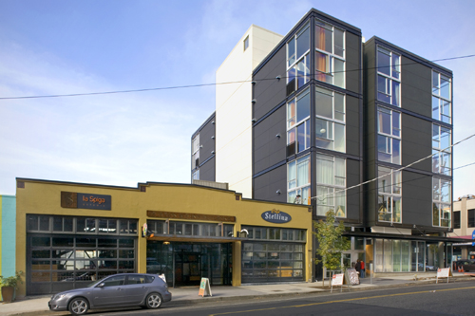

Objective: Reduce demolitions and improve building performance through research and policy development.
Preservation Green Lab Offices; Seattle, Washington
Seattle, Washington
Notes:
The National Trust has an entire field office that is dedicated to the advancing the connections between historic preservation and sustainability – the Preservation Green Lab which is based in Seattle.
We know at the National Trust – I suspect just about everyone in this room knows – that there are incredibly important and powerful connections between conserving our heritage and creating the sustainable communities. Preservation drives positive economic outcomes/ certainly positive social/cultural value of preservation. But what is less recognized is the environmental value that our older buildings bring.
We know that buildings are our greatest renewable resource; and so the mission of the Green Lab is quite simple: Make it easier to reuse existing buildings and make it easier to retrofit them for improved environmental performance – use less water, use less energy.
Since 2009 we’ve been working with a national network of partners to develop innovative research, advance public policy and increase private investment to reduce demolitions and improve building performance.
I’m delighted to be able to share some of the work with you today

Slide 4
Presentation Overview
Demolition Tends in the United States
Energy Performance of Older Buildings
Environmental Value of Building Reuse
Reducing Demolitions

Slide 5
U.S. Demolition Projections
2005−2030
27% Demolished
73% Retained
Source: Brookings Institution
Notes:
5
According to research from the Brookings Institution, approx. 27% of the existing building stock is expected to be demolished over the coming decades.

Slide 6
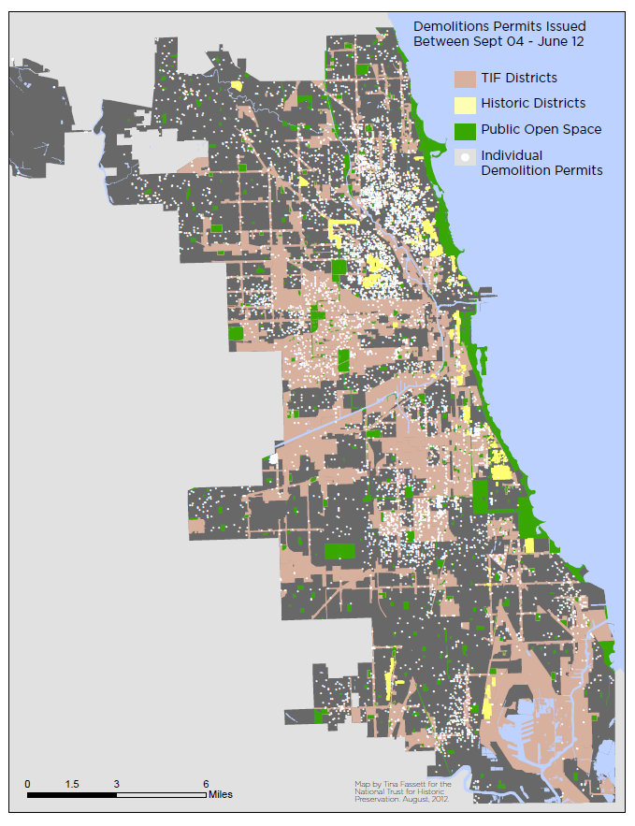
Chicago Demolitions
Area Demolished 2004-2012:
35 Million Sq Feet /
-- 3.4 Million Sq Meters
Approx 1.8 Sq Miles
-- 3 Sq Kilometers
530 Average City Blocks
2,353,000 Tons of Debris
Chicago, Illinois
Source: Preservation Green Lab

Slide 7


The Challenges to Reuse
Architects –prefer blank canvas
Industry/economy aligned behind new construction
Economics of reuse
Green Builders? Environmentalists?
Notes:
It’s not the architects, who want the glamour and fame that comes along with new construction
-- It’s not the various building industry trade groups – it’s fair to say that they mostly line up behind new construction
-- The economics often don’t support reuse (though in an ideal world it would…)
-- And, perhaps most surprisingly, it’s not the green building industry that’s really interested in seeing the maximum reuse of existing buildings.
I can’t do much about the architects, powerful industry trade groups, the economics of construction which don’t even come close to including the externalities of new construction.

Slide 8
Older Buildings and Energy
Average annual energy consumption Btu/sq. ft Commercial Buildings (non malls)
Before 1920 | 80,127
1920 - 1945 | 90,234
1946 - 1959 | 80,198
1960 - 1969 | 90,976
1970 - 1979 | 94,968
1980 - 1989 | 100,077
1990 - 1999 | 88,834
2000 - 2003 | 79,703
Source: U.S. Department of Energy, 2003

Slide 9
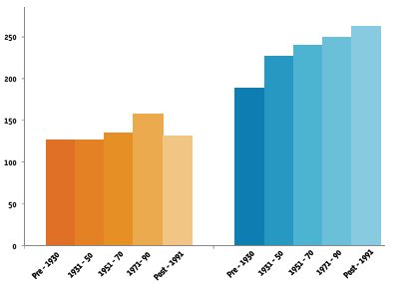
Older Buildings and Energy
Median Energy Use Per Sq Ft By Building Type and Age Group
Source EUI (annual kbtu/sq ft)
Multi-family Office
Year Built
Source; NY University/ City of New York Data 2011-2012

Slide 10
Older Buildings and Energy
Source: U.S. Energy Information Administration, 2005 Residential Energy Consumption Survey

Slide 11
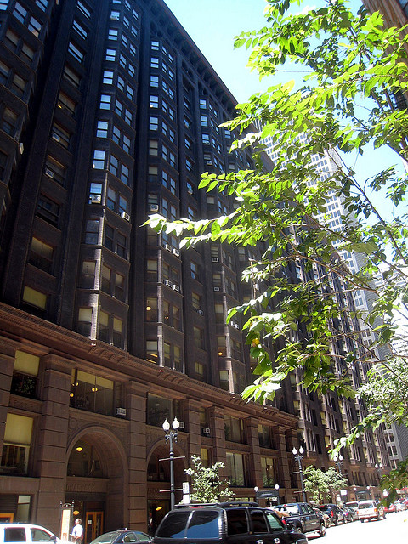
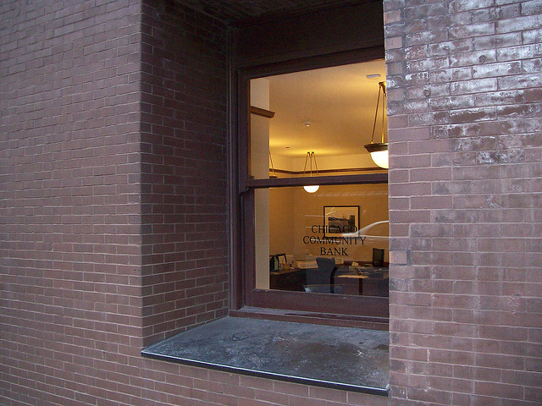
Older Buildings: Thermal Mass
Monadnock Building, Chicago
Notes:
They have green features inherent – Monadnock building and thermal mass
11

Slide 12
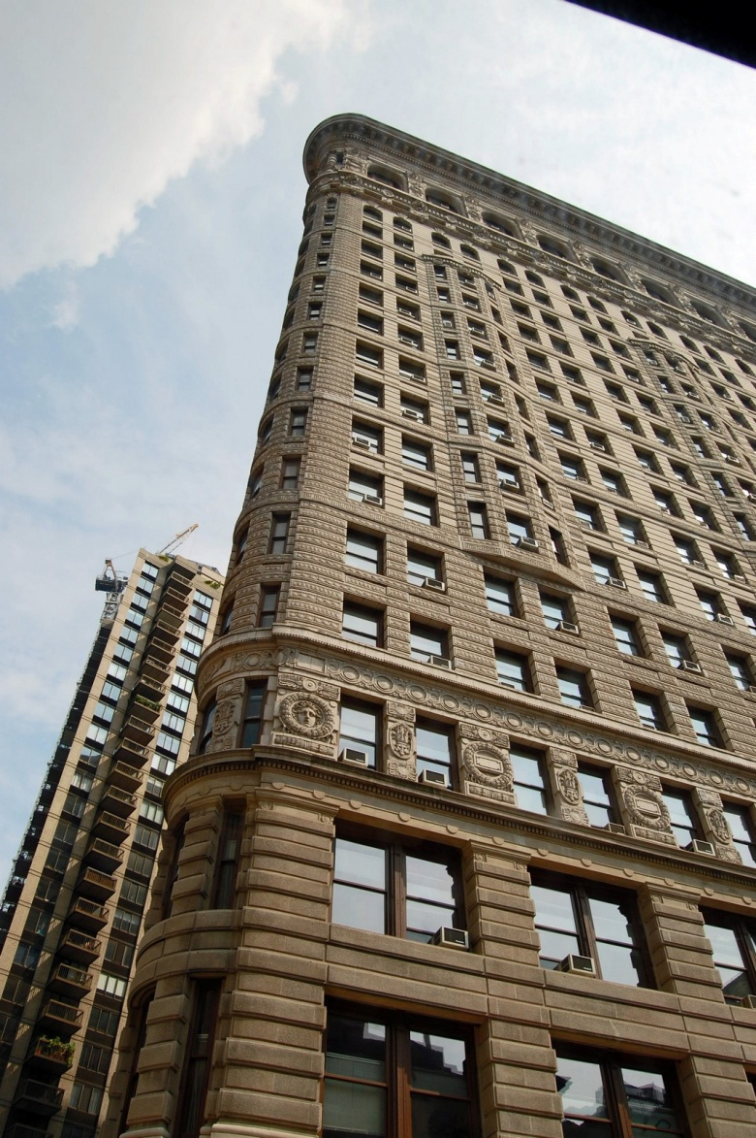
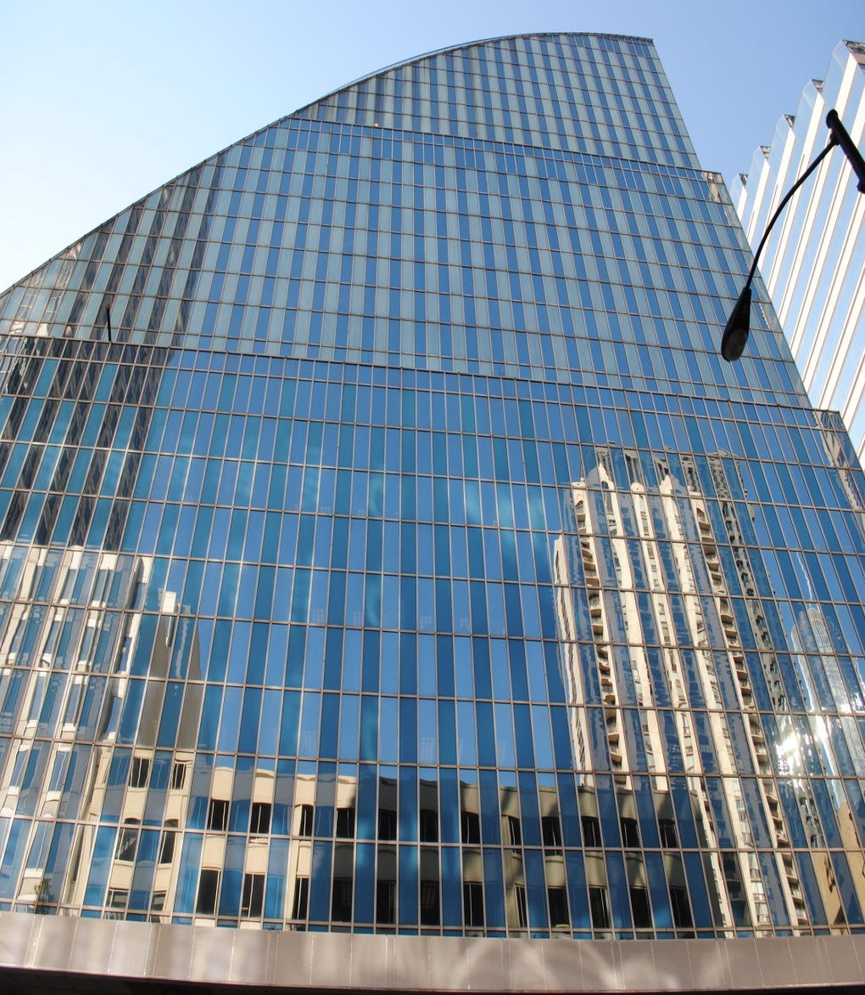
Older Buildings: Glazing/Windows
Source: Monica Arellano-Ongpin, Flickr
Chicago Architecture Today, Flickr
Notes:
They have green features inherent – Monadnock building and thermal mass
12

Slide 13
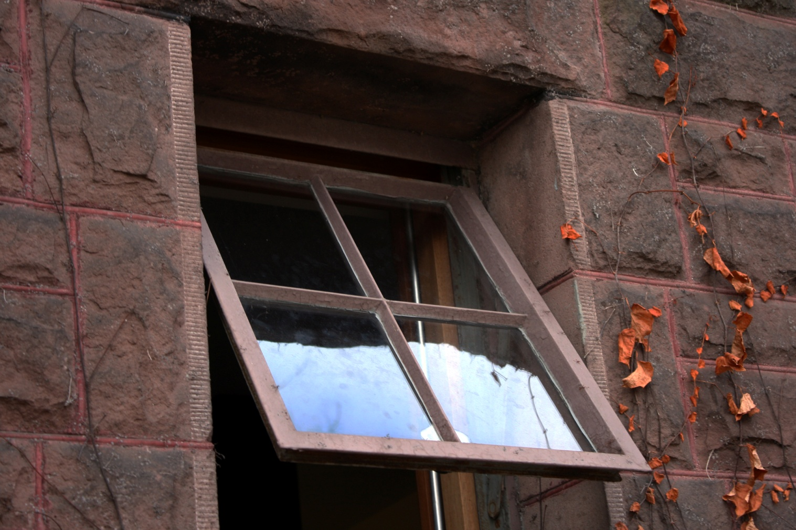
Older Buildings: Passive Ventilation
Source: Quinn.Anya, Flickr

Slide 14
Challenging Assumptions about Green Building
Building new, more efficient buildings is the only way to address climate change impacts related to the building stock.
The greenest buildings are the ones already built.
Notes:
Reusing existing buildings has many social, economic and cultural benefits. However, when it comes to their environmental value many viewpoints exist.
The rationale for the research that will be presented here is that many in the building industry make unfounded assumptions about green building as it relates to new and existing buildings.
With growing awareness and urgency in reducing the negative impact that buildings have on the natural environment, and in particular their contribution to climate change, it is sometimes assumed by green building and environmental advocates that only by reducing the operating energy of buildings can we reduce these impacts, and that the focus should be on new, more efficient buildings to steer our way back to a healthy planet.
By contrast, conservationists may assume that the building that is already built has the environmental advantage in that the materials to produce it have already been expended.
14

Slide 15
Previous Research: Residential
It takes between 35−50 years for a new, green home to recover the carbon expended during the construction process.
−Empty Homes Agency, UK, 2008
Notes:
15

Slide 16
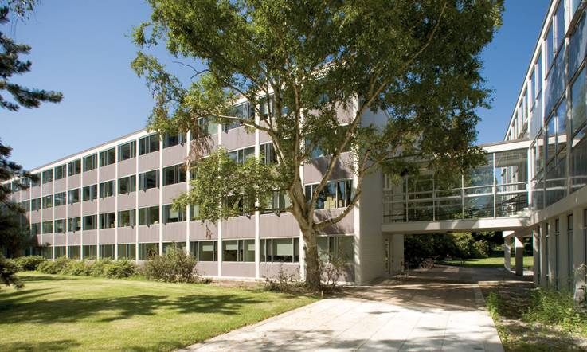
Previous Research: Institutional
2006 study compared new construction vs. renovation
Approx. 38 years for new, energy efficient building to recover the carbon expended during the construction process
Buchanan Building Complex, University of British Columbia. Courtesy Martin Nielsen Busby, Perkins & Will
Notes:
16
In 2006, the University of British Columbia studied the environmental impacts that could be expected from the replacement of the Buchanan building, which is located on the University’s campus. The LCA analysis used the Athena Institute’s Environmental Impact Estimator life cycle analysis tool to model the impacts that would be avoided by retaining the Buchanan building rather than replacing it with a new building. The analysis assessed the structure, envelope, and operational usage of the nearly 200,000 square-foot building and included an assessment that included raw material extraction, manufacturing of construction materials, construction of the structure and envelope, and associated transportation effects.
The study showed that reusing the Buchanan building would result in major environmental savings. It determined that, over an 80-year period, total carbon emissions for the new building were merely 5 percent lower. Furthermore, it would take approximately 38 years for a new, energy efficient building to recover the carbon that was expended during the construction process and begin to accumulate carbon savings. In other words, net carbon emissions savings for the replacement building would begin only after 38 years.

Slide 17
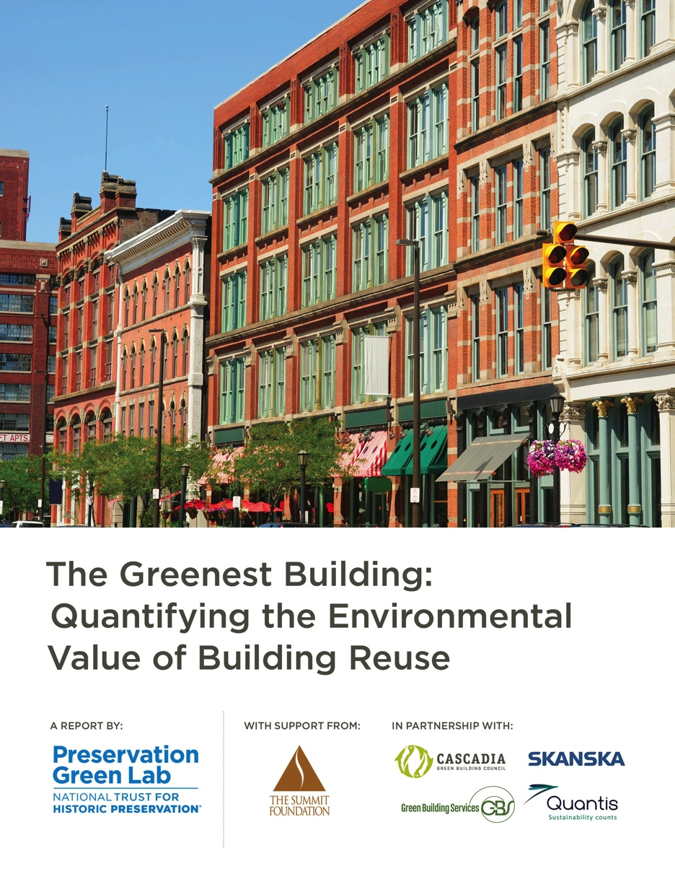
“The Greenest Building” Report
Notes:
17

Slide 18
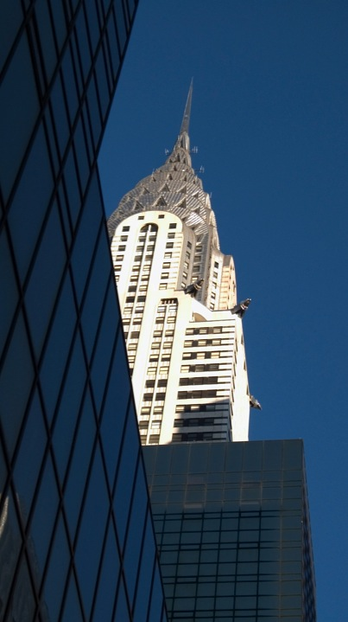
Under what conditions is building reuse environmentally preferable to demolition and new construction?
Do benefits differ by region and building type?
Are there significant opportunities to reduce near term carbon emissions by reusing buildings rather than constructing anew?
Guiding Questions
Notes:
A number of guiding questions led to this research. Understanding that buildings have such great environmental impact, this study seeks to answer under what conditions is building reuse environmentally preferable to demolition and new construction? Do the benefits of reusing and retrofitting a building, rather than tearing it down and building new, differ by region, climate or building type And are there significant opportunities to reduce near term carbon emissions by reusing buildings rather than constructing anew?
18

Slide 19
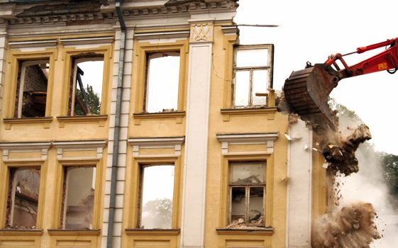
“Avoided Impacts” Approach
Embodied energy of existing building viewed as a “sunk cost”
Avoidance of environmental impacts that results from not constructing a new building
Madison Lenox Hotel Demolition, Detroit MI
Notes:
19
In contrast to building operating energy, embodied energy is required to produce a building. It includes the up-front
energy investment for extraction of natural resources, manufacturing, transportation, and installation of materials.
Recently, many building and environmental scientists have been dismissive of the embodied energy approach to quantifying the benefits of building preservation; energy embedded in an existing building is often viewed as a ‘sunk cost.’ That is, it is often argued that there is no inherent current or future energy savings associated with preserving a building, because the energy expenditures needed to create a building occurred in the past, as did the environmental impacts associated with creating the building. In this view, the only value of building reuse is the avoidance of environmental impacts that results from not constructing a new building. This approach has given rise to the avoided impacts approach to understanding reuse, which measures the impacts that are avoided by not constructing new buildings.

Slide 20
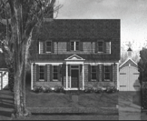

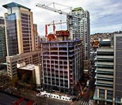





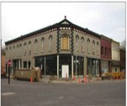

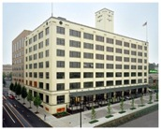
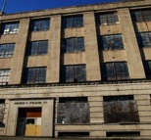
Case Study Buildings
Single-family
residential
Multifamily
residential
Commercial Office
Urban village
mixed-use
Elementary
schools
© National Trust for Historic Preservation, 2012.
Notes:
Six building types were selected for the analysis:
• Single-Family Residential
• Multifamily Residential
• Commercial Office
• Urban Village Mixed-Use
• Elementary School
• Warehouse (both conversion of a warehouse to commercial office and to residential)
This slide shows the actual buildings used in the analysis.
20

Slide 21
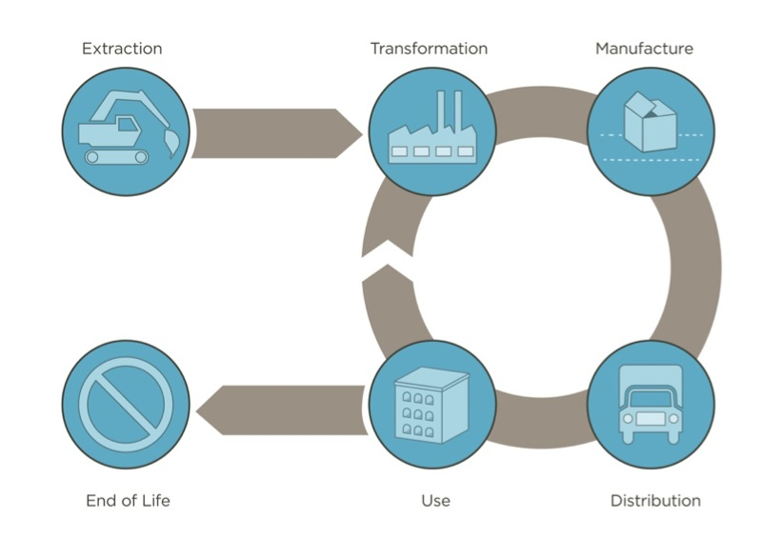
Lifecycle Stages
© National Trust for Historic Preservation, 2012.
Notes:
Each renovated case study building is evaluated against it’s comparable new construction scenario using Life Cycle Assessment (LCA). The study looks at the entire life cycle of the buildings, from the extraction and processing of all raw materials through the end of life of all building components including:
Extraction of raw materials for production of both new and replacement materials.
Transformation and refinement of raw materials.
Manufacture of products and distribution to suppliers.
Transportation of products to building site.
Use of building including construction-related activities and operating energy of the building over its lifespan.
End of Life disposal of materials, including transportation, to landfill, recycling or incineration.
21

Slide 22
Life Cycle Impact Assessment
Resources
Ecosystem quality
Human health
Climate Change
Non-renewable energy
Mineral extraction
Aquatic ecotoxicity
Land occupation
Terrestrial acidification & nutrification
Terrestrial ecotoxicity
IMPACT2002+
Human toxicity
Ionising radiation
Ozone layer depletion
Photochemical oxidation
Respiratory effects
Notes:
Life cycle impact assessment (LCIA) classifies and combines the flows of materials, energy and emissions into and out of each product system by the type of impact their use or release has on the environment. The method employed here is the peer-reviewed and internationally-recognized LCIA method IMPACT2002+ v2.07. The exception to this is the climate change indicator, which is calculated based on the IPCC 2007 100-year GWP weighting. This method uses the most current science with regard to global warming and offers the greatest consistency with data that might be presented elsewhere.
Inventory flows are entered into published algorithms to calculate various impacts.
This slide shows the four major impact categories evaluated in this study, and the subcategories (midpoints) that are included in Resource, Ecosystem Quality and Human Health impact.
Note that for Human Health impacts, only those occurring from the release of substances into the outdoor environment and human exposure to that environment are considered, direct exposure through indoor air or exhaust is excluded and is currently beyond the capabilities of life cycle science due to lack of information and established methods in LCA.
Important to note that you cannot compare results across categories and this study makes no attempt to weight indicators.
22

Slide 23

Climate Regions
Portland
(Mild Climate)
Chicago
(Cold Climate)
Phoenix
(Hot/Dry Climate)
Atlanta
(Hot/Humid Climate)
23
Notes:
Four cities representing different US climate regions were selected to analyze the effect that climate (and grid mix) has on results: Portland (temperate), Phoenix (hot-arid), Chicago (cold) and Atlanta (hot-humid).
23

Slide 24
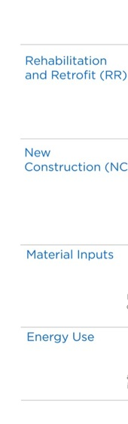
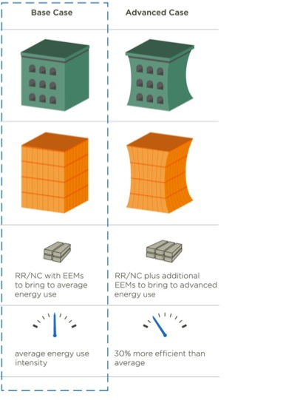
Test Conditions
© National Trust for Historic Preservation, 2012.
24
Notes:
Two energy “test conditions” are analyzed in the study.
Base Case. Represents a typical building, renovated or built to meet contemporary energy code standards. The Base Case assumes that buildings in both the NC and RR scenarios have the same operating energy performance. This test condition assumes that a renovated building has been retrofitted to include energy-efficiency measures (EEMs), such that it is operating on par with new construction.
Advanced Case. Represents an energy performance improvement over the Base Case. This test condition evaluates environmental impacts when buildings are operating at an advanced level of energy efficiency. For the Advanced Case, both buildings include EEMs that increase their operating energy performance by an estimated 30 percent .
24

Slide 25
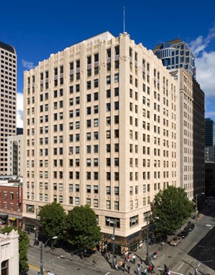
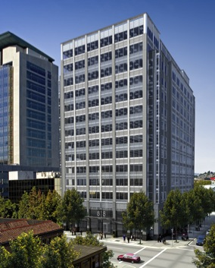
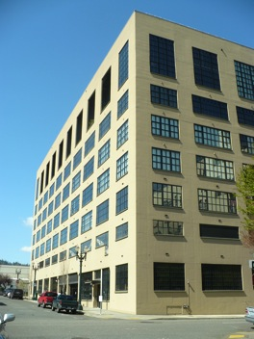
Findings: Reuse Matters
Building reuse almost always yields fewer environmental impacts than new construction when comparing buildings of similar size and functionality.
© National Trust for Historic Preservation, 2012.
Notes:
Reuse Matters
In general, building reuse almost always yields fewer environmental impacts than new construction when comparing buildings of similar size, functionality and energy efficiency. This result was found to be true irrespective of climate—though differences in climate can affect the extent of savings offered by reuse.
25

Slide 26
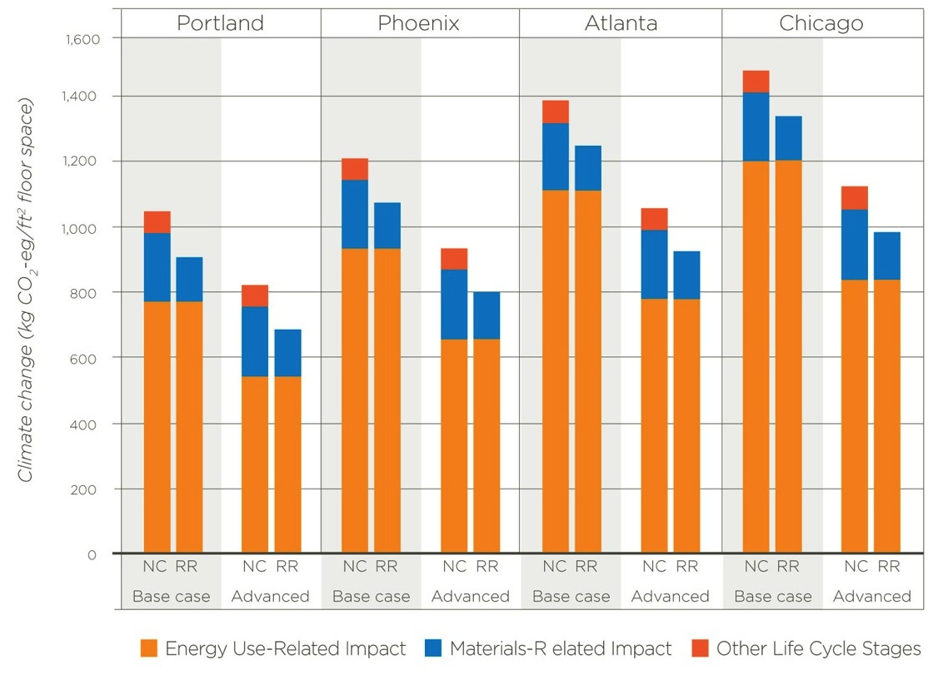
Findings: Reuse Matters
Commercial Office: Climate Change Impacts
NC = New Construction
RR = Reuse and Retrofit
© National Trust for Historic Preservation, 2012.
Notes:
This graphs shows the same commercial office building but hones in on the climate change impact category. NC and RR results are shown for both the base and the advanced case test conditions. The graph shows that energy use drives climate change impacts and as energy use is reduced in the advanced case scenarios, impacts go down. However, RR still outperforms NC over the 75-year period.
26

Slide 27
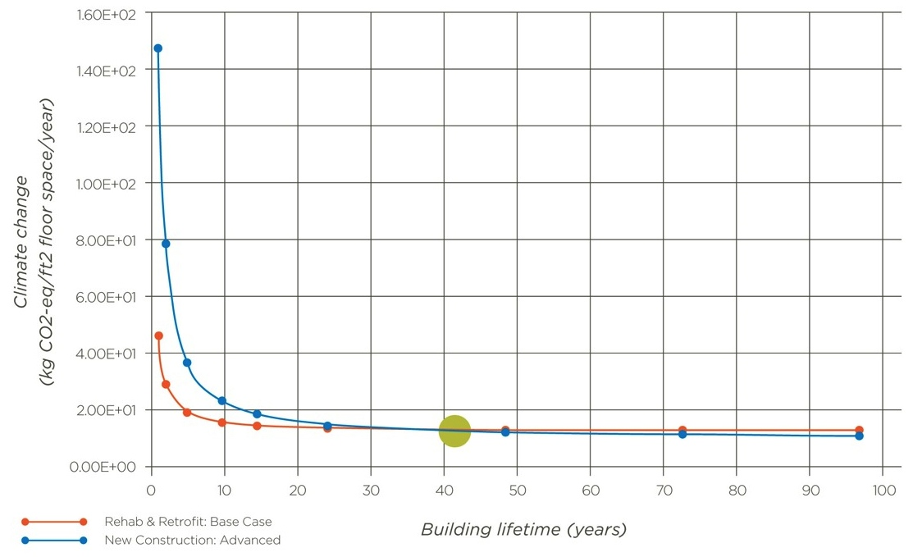
Findings: Reuse Matters
Commercial Office, Portland: Climate Change Impacts
© National Trust for Historic Preservation, 2012.
Notes:
This chart compares the climate change impacts for the Portland commercial office building at various lifespans. The NC Advanced case is shown in blue, the RR base case is shown in orange. Impacts are plotted at year 1, 5, 10, 15, 25, 50, 75 and 100. In this instance, it takes until year 42 before the impacts of the energy efficient new construction building outweigh the average performing existing building.
27

Slide 28
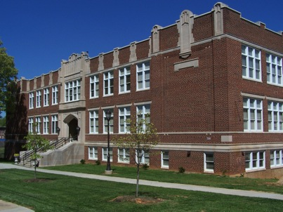
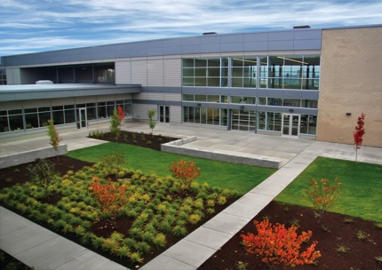
Findings: Reuse Matters
It can take between 10 to 80 years for a new energy efficient building to overcome, through efficient operations, the climate change impacts created by its construction.
© National Trust for Historic Preservation, 2012
Notes:
While these results may be obvious, the more interesting results are shown when an average performance existing building is compared to the more energy efficient new construction building. In this comparison, the new construction building does perform better of the 75-year life span, however, it often takes decades for the new building to compensate, through efficient operations, the initial environmental impacts from the construction process. In this way, even retrofitting buildings to average levels of energy performance offers immediate climate change impact reductions.
28

Slide 29
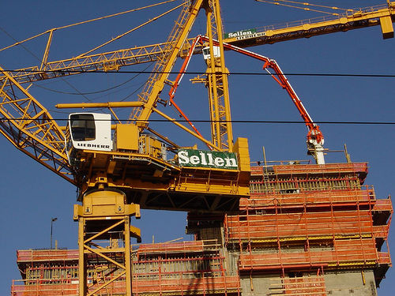
Findings: Reuse Matters
The majority of building types in different climates will take between 20-30 years to compensate for the initial carbon impacts from construction.
Seattle Washington Mutual Tower Under Construction; Source: Flickr

Slide 30
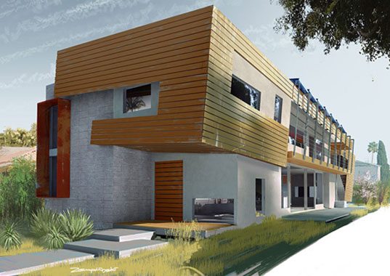
Findings: Reuse Matters
A single family home will take between 38-50 years to compensate for the initial carbon impacts from construction.
Project7ten - California (pending LEED Platinum); Inhabitat.com

Slide 31
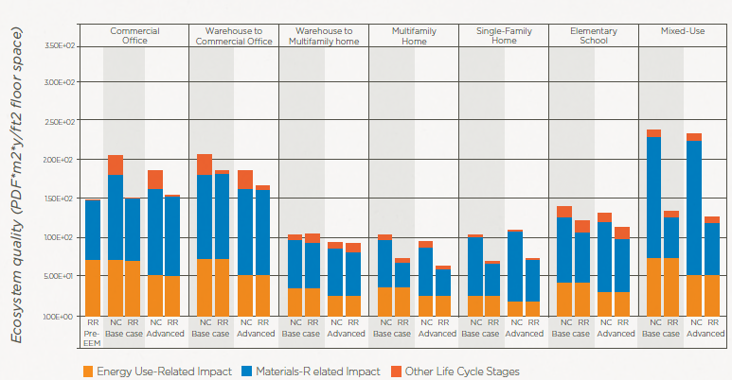
Findings: Reuse Matters
Improving energy efficiency can increase other negative environmental impacts.
Ecosystem Quality Impacts - Portland

Slide 32
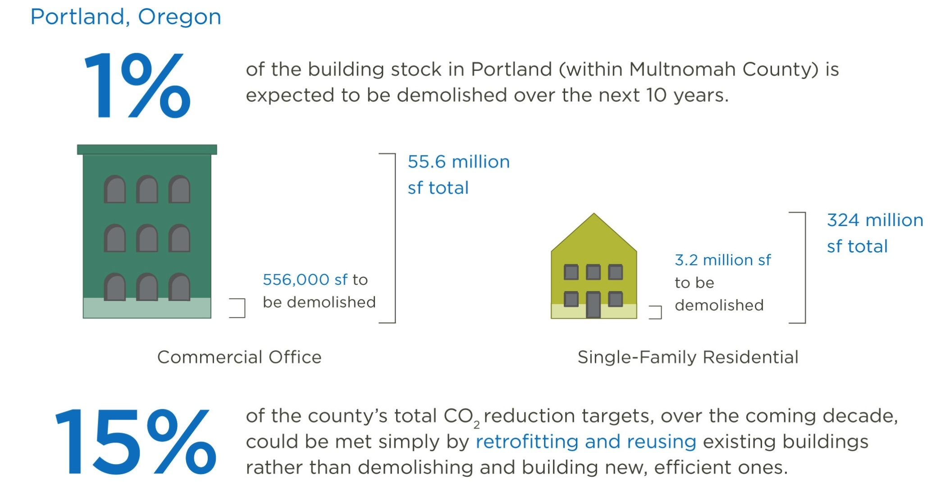
Findings: Scale Matters
© National Trust for Historic Preservation, 2012.
Notes:
These reuse-based savings may seem small when considering a single building. However, the absolute carbon-related impact reductions can be substantial when these results are scaled across the building stock of a city. Consider this example: In Portland, Oregon retrofitting just 1 percent of the office buildings and single family homes that would otherwise be demolished and rebuilt over the next ten years would help to meet 15 percent of the county’s total CO2 reduction targets.
32

Slide 33
Findings: Design Matters
The quantity and type of materials used in a building renovation can reduce, or even negate, the environmental benefits of reuse when compared to new construction.
.
© National Trust for Historic Preservation, 2012.
Notes:
There’s another important point of this study—and that is that design of buildings really matters. Those buildings that tend to use the fewest materials will have the most significant environmental savings—and in fact that benefits of reuse can be eroded. This suggests that it’s important to make sure buildings are designed carefully, and building designers have better tools that enable them to choose materials with the best environmental profile.
33

Slide 34
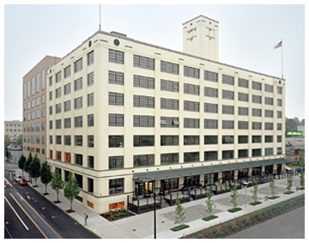
Findings: Design Matters
Warehouse to residential exception
Material inputs resemble new construction
Further research needed on material and energy use of warehouse conversions
© National Trust for Historic Preservation, 2012.
Notes:
A notable exception to these findings is that one building type did not show a decrease in ALL environmental impact : the warehouse to residential conversion. In this scenario, the quantity and type of material inputs needed to undergo a change of use demonstrated that the building actually had GREATER impacts over demolition and new construction in some, but not all, impact categories. This points to the finding that renovated buildings that use large amounts of material inputs perform on par with new construction. Further research is needed in order to understand if the materials specific to this warehouse conversion were typical and to understand actual energy consumption of these building types.
34

Slide 35

Reducing Demolitions
What are the market and policy barriers to reuse?
How do these vary by city/location?
What incentives are needed to increase reuse?

Slide 36
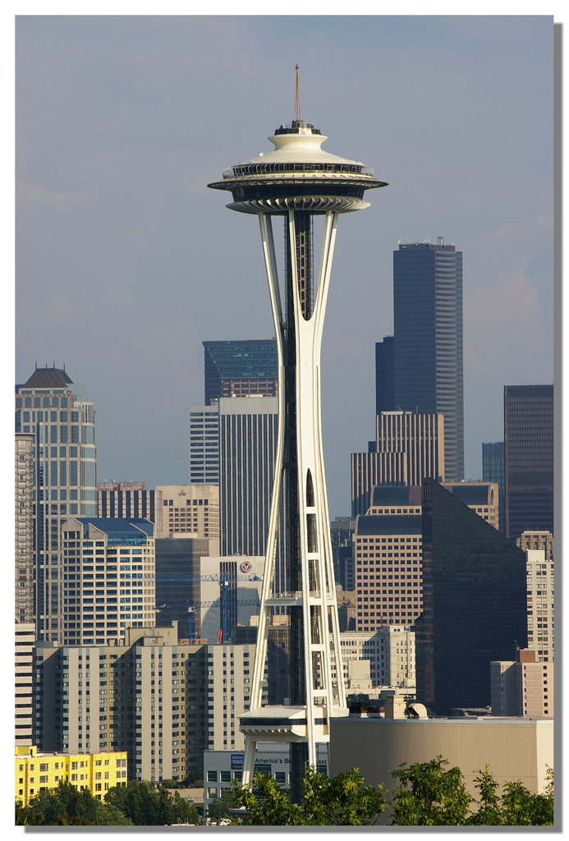
Reducing Demolitions
Pioneering new energy code based on flexibility and measurement
Exploring incentives for seismic-retrofits
Identifying financing sources for green retrofits
Seattle Space Needle
Source: Flickr

Slide 37
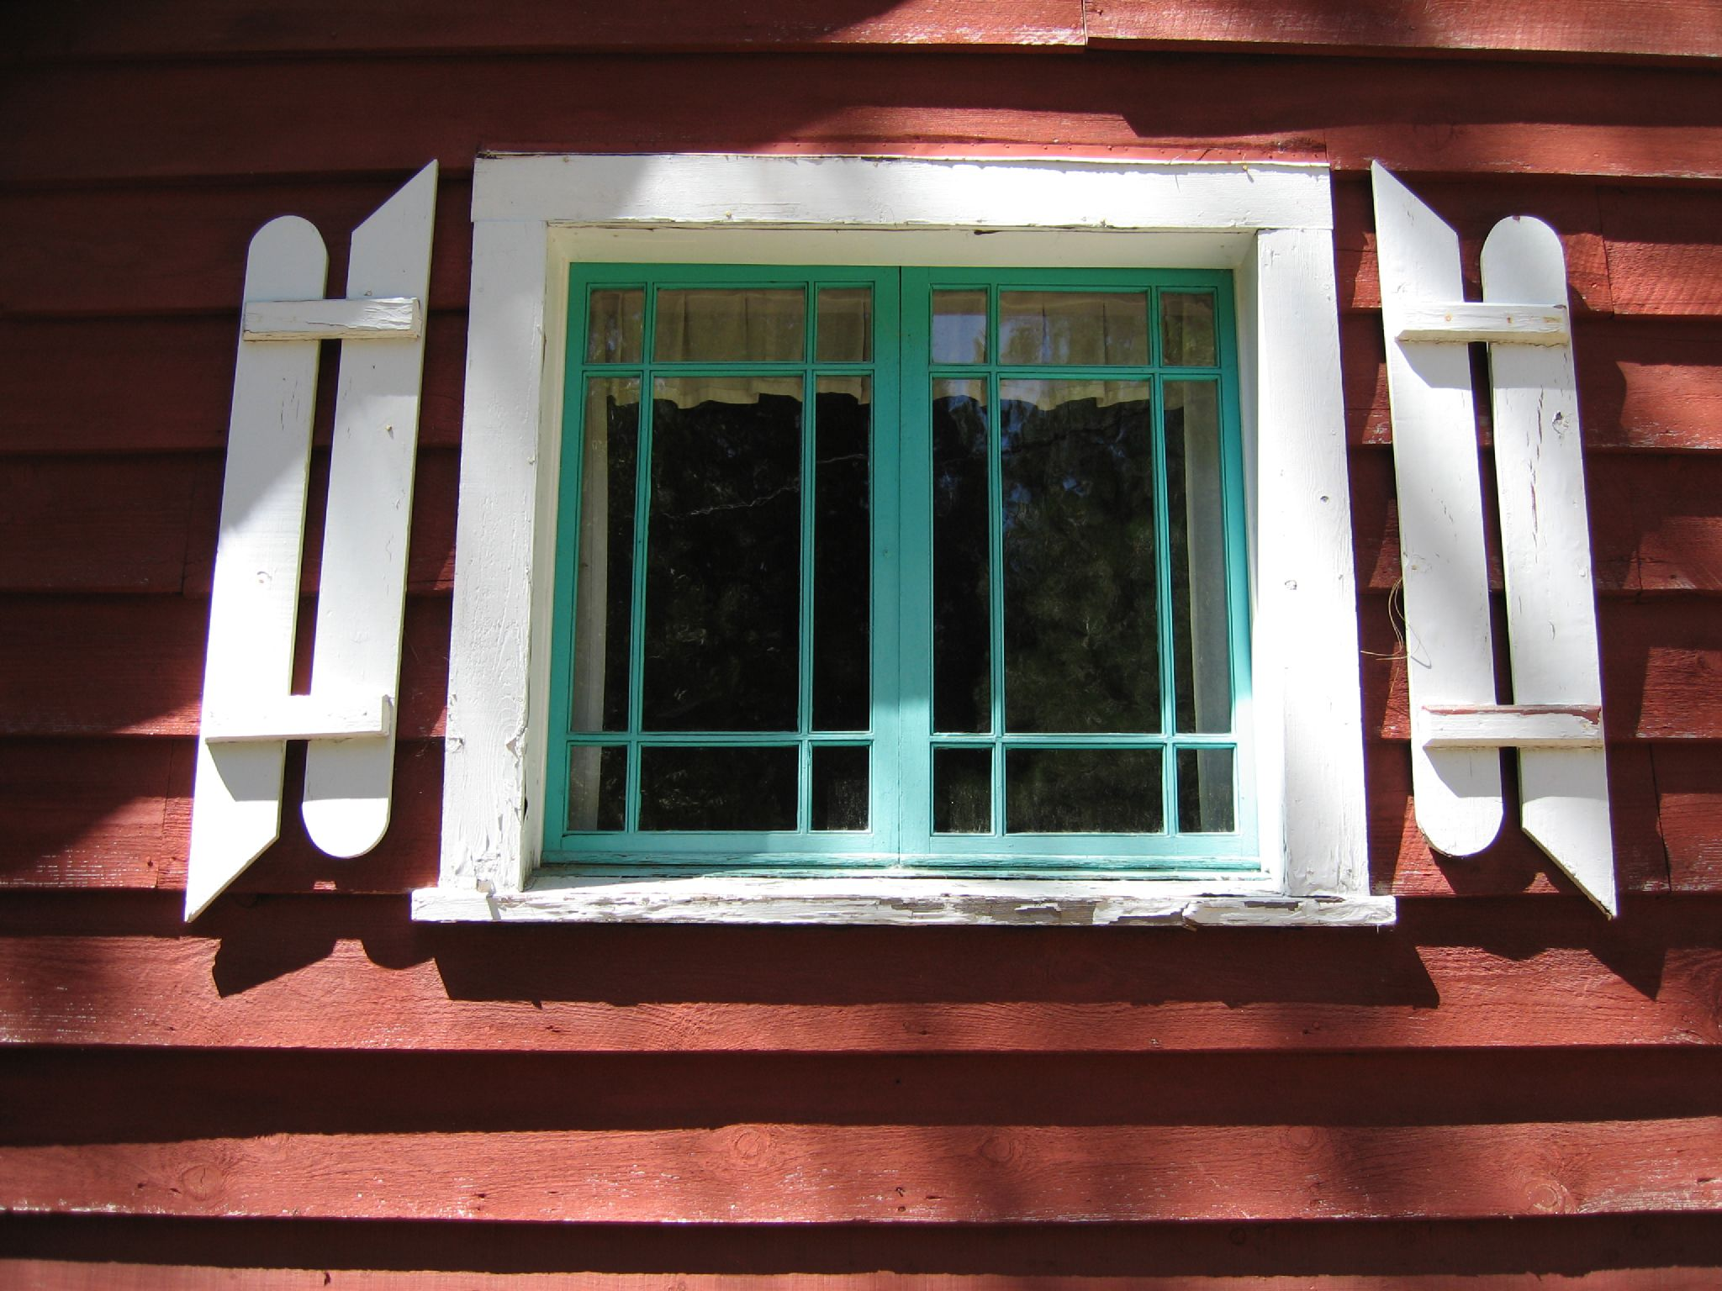
Reducing Demolitions – Windows
Source: Kevitivity, Flickr

Slide 38
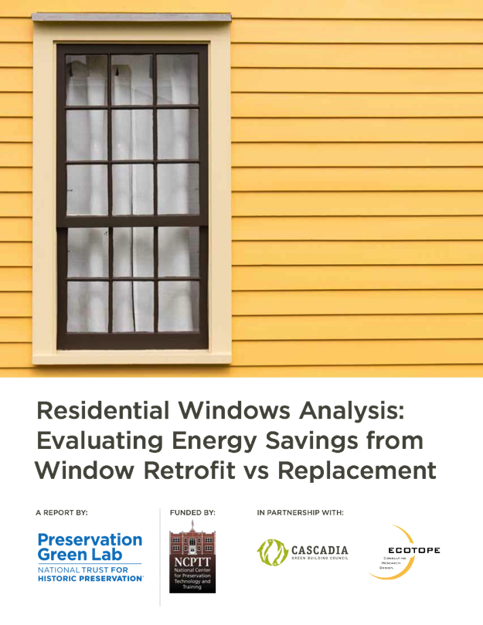
Windows Study
Objectives
Characterize performance of older, leaky, single pane residential windows
Compare the relative energy savings from window upgrade measures
Provide recommendations related to improving window performance across different U.S. climate regions.
D R A F T

Slide 39
Windows Study Climate Regions
Portland
(Mild Climate)
Boston
(Cold Climate)
Chicago
(Cold Climate)
Phoenix
(Hot/Dry Climate)
Atlanta
(Hot/Humid Climate)
39
Notes:
Four cities representing different US climate regions were selected to analyze the effect that climate (and grid mix) has on results: Portland (temperate), Phoenix (hot-arid), Chicago (cold) and Atlanta (hot-humid).
39

Slide 40

Green Lab Windows Study
Findings
Retrofit Measures Can Achieve Performance Results Comparable to New Replacement Windows.
Almost Every Retrofit Option Offers a Better Return on Investment than Replacement Windows

Slide 41
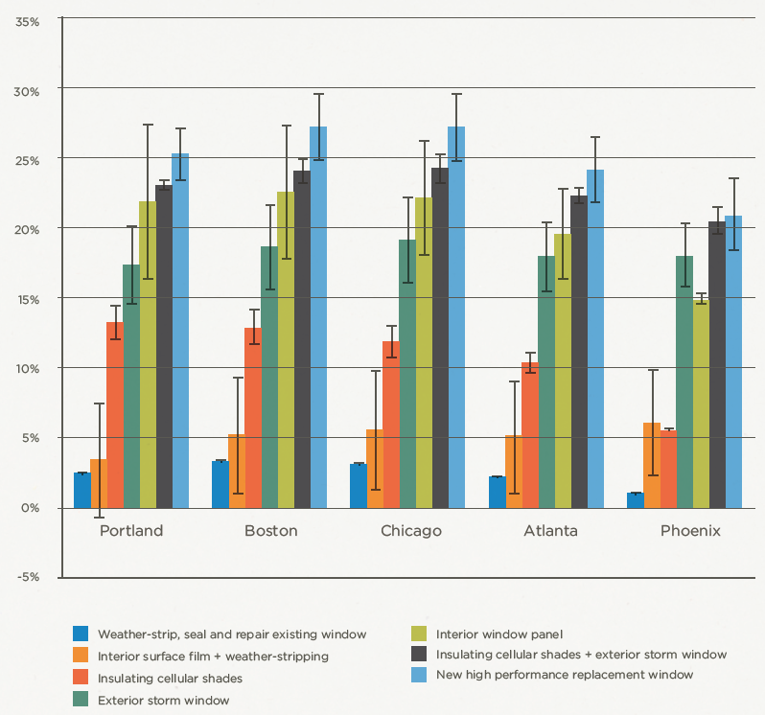
Green Lab Windows Study
ANNUAL PERCENT ENERGY SAVINGS FOR VARIOUS WINDOW UPGRADE OPTIONS

Slide 42
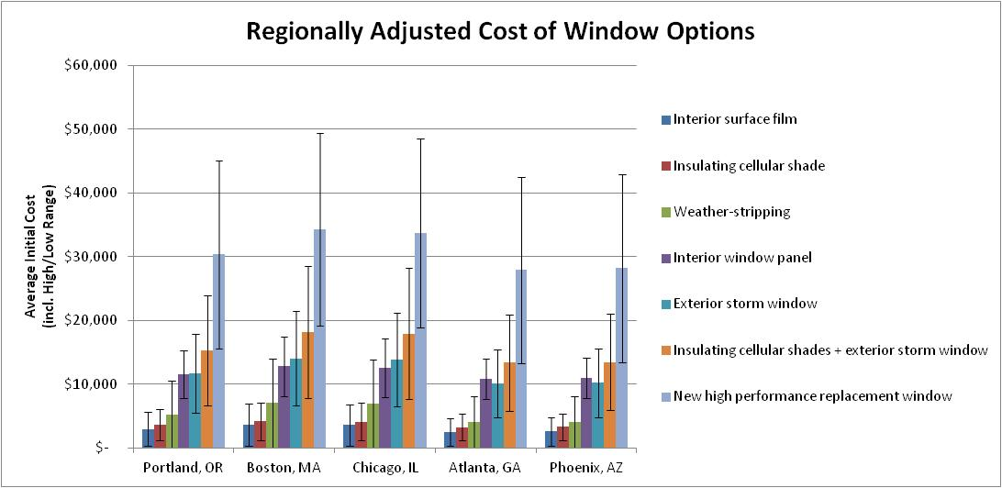
Green Lab Windows Study

Slide 43
Concluding Thoughts
Energy performance of older buildings tends to be very good; “good bones” to work with
Demolition/new construction create significant environmental impacts;
Conclusion: Reuse is a key environmental solution

Slide 44
Tusen takk! PFrey@savingplaces.org

Slide 45

Older Buildings: Durability
Source: Scooter, Flickr
Notes:
They’re adaptable to new uses… Patrice—this compares The old brick of Seattle's Pioneer Square with the new modern buildings in the background…showing that these buildings have survived many uses because they are durable and sound.
45

Slide 46
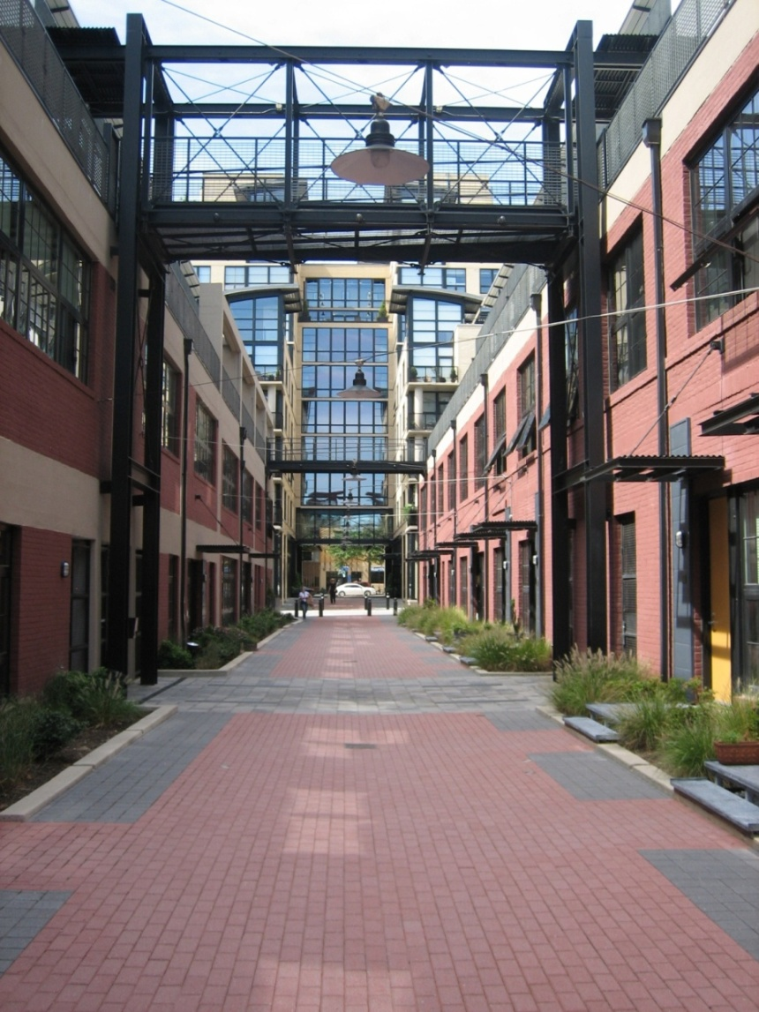
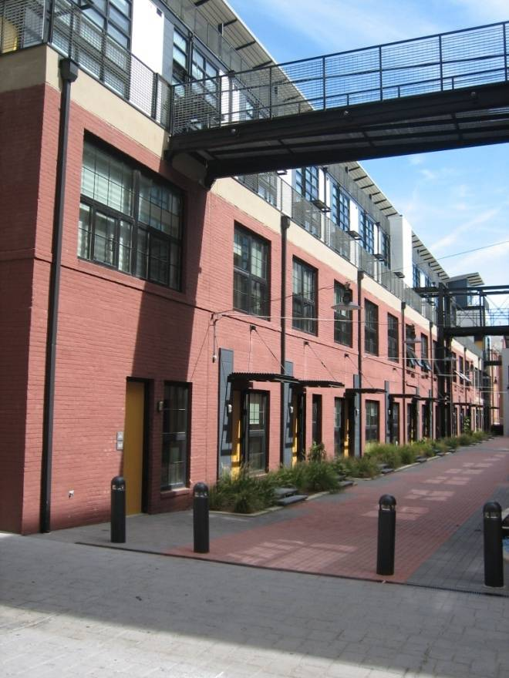
Older Buildings: Adaptability
Union Row Apartments, Washington DC
Notes:
ptable to new uses…
46

